Slide 1
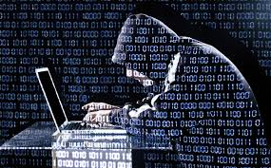
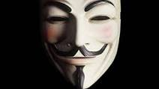
When, Not if
The Cyber Security Challenges among local government
UMBC Public Policy Forum
Baltimore Maryland
April 15, 2016
Gayle B. Guilford
CISO
Baltimore City Government

Slide 2
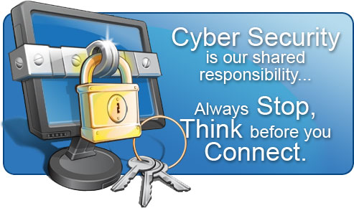
Federal and State Requirements
When Not, If

Slide 3
WHEN , NOT IF
Federal and State Requirements
PCI DSS and PII - restrictions and guidelines
In February 2013, President Obama issued Executive Order 13636 “Improving Critical Infrastructure Cybersecurity”
NIST - Commerce Department's National Institute of Standards and Technology framework guidelines provides the description of what's needed for a comprehensive cybersecurity program
CJIS – data security protection for CJI (add CJIS if necessary)
Md 304 Governmental Procedures – Security and Protection of Information Requiring State and local government units, when destroying records of an individual that contain personal information of the individual, to take reasonable steps to protect against unauthorized access to or use of the personal information under specified circumstances; requiring a government unit that collects specified personal information of an individual to implement and maintain specified security procedures and practices; etc. Synopsis of Laws Enacted 127 Chapter No. EFFECTIVE JULY 1, 2014

Slide 4
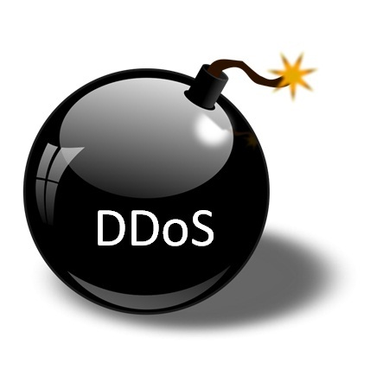
Concerns!
WHEN , NOT IF
Distributed Denial of Service - DDoS
The Ponemon Institute published “2015 Cost of Data Breach Study” in May 2015. The study stated “The cost of (a) or (data breaches) data breach varies by industry. The average global cost of (a) data breach per lost or stolen record is $154. However, if a healthcare organization has a breach the average cost could be as high as $363 and in education the average cost could be as high as $300. The lowest cost per lost or stolen record is in transportation ($121) and public sector ($68). The retail industry’s average cost increased dramatically from $105 last year to $165 in this year’s study.”
Symantec April 2015 Volume 20 Report -2015 Internet Security Threat Report Government reports “a 183 percent increase in DNS amplification attacks between January and August 2014”.

Slide 5
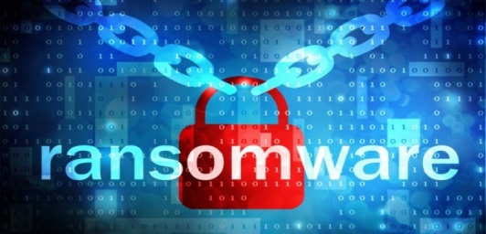
Concerns!
WHEN , NOT IF
New Ransomware
As reported by CBS news on April 11, 2016 – “ An unusual strain of virus-like hacker software that exploits computer server vulnerabilities -- without requiring human interaction -- is a leading example of a new generation of "ransomware," according to a new report by Cisco Systems Inc.
Hackers use such software to target large-scale networks and hold data hostage in exchange for bigger payments.
Last year's 2,453 reports of ransomware hackings to the FBI totaled a reported loss of $24.1 million, making up nearly one-third of the complaints over the past decade. They also represented 41 percent of the $57.6 million in reported losses since 2005. Such losses are significantly higher than any paid ransoms because companies routinely include remediation costs, lost productivity, legal fees and sometimes even the price of lost data in their estimates.

Slide 6
WHEN , NOT IF
Concerns!
Insufficient Funding
Lack of Resources
How to Educate Non IT Staff
How to Educate Citizens
Lack of Control over External Devices
Identification of Acceptable and Non-Acceptable Risk
Identification of All Assets

Slide 7
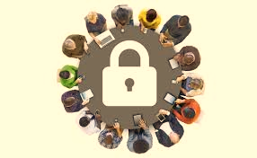
WHEN , NOT IF
Partners
Employees
Citizens
Vendors
Cyber Security Is Our Shared Responsibility

Slide 8
How Do we prepare
WHEN , NOT IF
Educate Users
Partnerships
Review 3rd Party Contracts
Review and Update Policies
Implement Tools

Slide 9
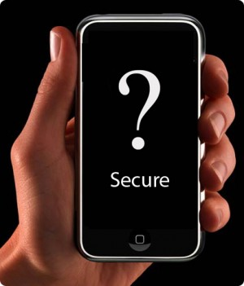
Educate Users
WHEN , NOT IF
Weakest Link verses Strongest Link
Can spot and report oddities
Should be suspicious
Must use Strong Passwords
Connect to Internet with Caution
Must Secure mobile Devices

Slide 10
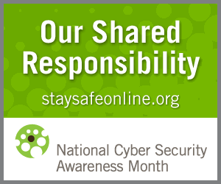
Partnerships
WHEN , NOT IF
Industry or Sector Information sharing Teams and Committees
Government Officials (I changed it, it was misspelled)
Vendors
Regional Committees
Fusion Centers (A fusion center is a collaborative effort of two or more agencies that provide resources, expertise and information to the center with the goal of maximizing their ability to detect, prevent, investigate, and respond to criminal and terrorist activity)
Local Universities
FBI Regional Cyber Security Office
Homeland Security
Federal Agencies
In-House Facilities Management
In-House Risk management
In-House Procurement
In-House Human Resources

Slide 11
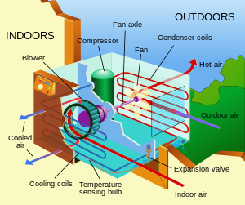
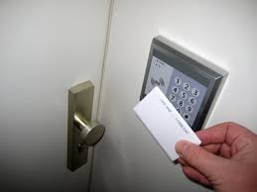
Review 3rd party contracts
WHEN , NOT IF
HVAC
Electronic Identification
Electrical
3rd Party processing
Websites
ISP Providers

Slide 12
Review and update Policies
WHEN , NOT IF
Times have changed
Physical security and electronic access
Physical infrastructure and remote access
User Remote Access
Internet access
Email
Termination

Slide 13
Implement Tools
WHEN , NOT IF
In order to fight the Cyber-War and be in compliance with State and Federal laws, we must implement the CyberSecurity policies in line with state and federal laws, identify and mitigate risks while implementing software and/or equipment designed to:
Detect and Stop
Expose the Cyber-Attack Life Cycle
Report Cyber-Attack
Produce Forensic Attack Details

Slide 14
Celebrate Cyber Security month October
WHEN , NOT IF

Slide 15
WHEN, NOT IF
Ever Changing Digital Environment
More Sophisticated Attacks
More Technology Vulnerabilities
Human Element
Policy (Policies) and Practices
Trained Technical Staff
Budget

