Slide 1
The Maryland All-Payer
Hospital Rate Setting System:
A Look Back – How did we Get Here?
Dept. of Public Policy, Maryland Institute for Policy Analysis and Research and Hilltop Institute
Controlling Maryland Hospital and Health Care Spending
in the Era of Budget Caps
Baltimore, Maryland
December 5, 2014
Presented by Robert Murray (former Executive Director, Maryland HSCRC)
GLOBAL HEALTH PAYMENT, LLC

Slide 2
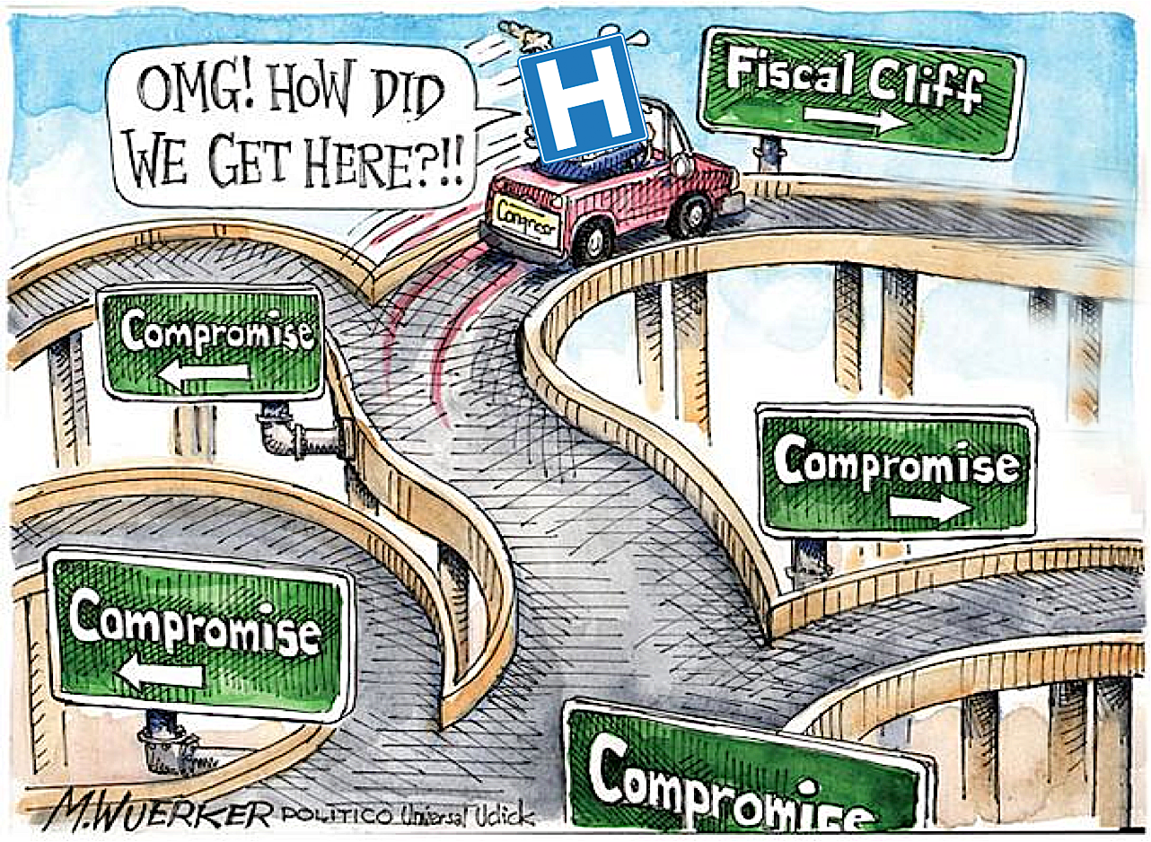
HSCRC – the “Board Game” by Milton Bradley
The Game has a lot of twists and turns and some very suspenseful moments
High Value Health System
HSCRC
Waiver Limbo, IPPS and lose $1.5 billion
Buy docs, build, build, build – maximize revenues
Abandon Rate Setting
Massachusetts style
Monopolies
The Long and Winding Road – A Look Back
Notes:
Today, I will describe Maryland’s Unique All-Payor Hospital Rate Setting system
This will include a discussion of the basic characteristics and key features
A review of the performance results and achievements of the system along the dimensions of Cost Containment, Access to Care, Equity in Payment, Financial Stability and Public Disclosure
Then I will turn to a discussion of the policy issues that Rate Setting can address. These are policy issues that most all countries face – whether they have centralized financing systems, a high degree of government control and intervention, or a fragmented pro-competitive system as in the USA.
Then finally conclude with summary observations

Slide 3
First: a Quick Overview of Hospital Rate Setting
HSCRC created in 1971 with jurisdiction over hospital costs (IP & OP facility only) with rate setting authority for commercial payers
Began negotiations with Medicare (HCFA) in 1972 for an all-payer waiver (in effect when all hospital rates set: 1977)
The “Medicare waiver” (initially a demonstration waiver) made the system “all-payer” allowing for Medicare and Medicaid
System was based on historical costs – (but a focus on outliers)
Established a prospective rate setting system - annual rate updates
Initially a system of “Unit rates by Revenue Center”
Uniform Markups of Charges over Cost
System of Financing “reasonable” Uncompensated Care”
GLOBAL HEALTH PAYMENT, LLC

Slide 4
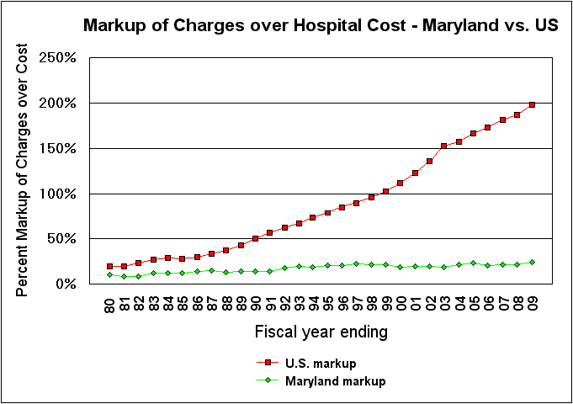
Payment Equity
Hospitals nationally mark
up their charges
200% above cost
US
Hospital
markups
MD
Hospital
markups
Markup also
Includes a “reasonable
Provision” for hospital
Uncompensated Care
• HSCRC controls the “markup” of price over cost
• HSCRC also prohibits price-discrimination/cost-shifting
•Maryland has the lowest markups and lowest charges in U.S.
Source: American Hospital Association statistics 1980 - 2009

Slide 5
Original Waiver test was a “per case payment relative rate” of Growth Test”
Maryland passes the test as long
As it grows more slowly than Medicare
(i.e., can’t get back to 30% higher level)
Absolute Test
Maryland was 30% higher than
Medicare in payment per case in 1981
Value of the Waiver in terms of
Enhanced Medicare and Medicaid
Payments to Maryland = $1.5 – $2 billion
Per year!
Notes:
This graph illustrates the Financial test we have to pass to keep the Waiver from the Federal Medicare Program. We must simply control the rate of growth of Medicare payment per case and grow more slowly than Medicare payments per case nationally. A favorable test to Maryland since we started about 30% HIGHER than the US average back in 1980.

Slide 6
Other Features of the Baseline System
Extensive data collection clinical and financial (inpatient case mix data set the best in the world)
1977 HSCRC changed the Basis of Payment to DRGs
  First DRG-based payment system in the world
Focus on outliers led to development of the “Screens” – identifying high cost providers for corrective action
Outpatient payment – still unit rates
Strong Cost control mechanisms/policies 1977-1989 but no quality-related P4P
Maryland and all State-based Rate Setting Systems had a System of Volume Adjustments
GLOBAL HEALTH PAYMENT, LLC

Slide 7
Volume Adjustment System (VAS)
Under DRG System, Hospitals have 3 Primary Incentives:
  Minimize Cost Per Case
  Maximize Revenue Per Case (Coding has an impact here)
  Maximize Case Volumes
Volume Adjustment System: Reflect Hospital Fixed/Variable Costs
  Over the Short Term (in general) Hospital Fixed Costs are about 40-60%
  In absence of a Volume Adjustment, New cases: Marginal Revenue > Marginal Cost
  Marginal case hospital retains 100 cents on the $ when cost is 50 cents on the $
  New Volumes add substantially to Profitability and Cash Flow
All State Based Rate Systems in US had Volume Adjustment
  Economically Sound: Reflects Fixed and Variable Components of Cost
  Acts as a “Break” on incentive to do unnecessary volume
Implication: Large incentive to admit more cases; Greatly Undermines Cost Control
Question this now
Given most CMS
Experiments are all
About controlling
Unnecessary volume
Oddly – Medicare didn’t contemplate the use of a Volume Adjustment
GLOBAL HEALTH PAYMENT, LLC

Slide 8
Volume Adjustment System (continued)
Volume inducing feature of FFS payment has undermined cost containment in Maryland and Nationally
Major factor behind Hospital expansionary strategies (building projects, questionable new technologies, buying docs, etc.)
Increase volumes = excess Marginal Revenues over Marginal Costs and this surplus is reinvested in expansionary strategies that again increase volumes
Particularly true for non-profit hospitals (no need to distribute profits to owners – instead use increased cash flow from volume increases to expand and generate more volumes)
Responsible for the view that “Hospitals are self-fueling, ever-expanding machines” (James Robinson, UC Berkeley)
GLOBAL HEALTH PAYMENT, LLC

Slide 9
Implications: Collapse of Managed Care & Removal of VAS
Maryland VAS was effective – but policy changed over time
  1977-89: Costs treated 50%/50%: VC/FC (hospital retains 50 cents on $ for volume)
  1990-2001: Some hospitals negotiated 100% VC arrangements
  Rest of the system placed on 85%/15% VC/FC (hospitals retained 85 cents on the $)
  2001: 100% VC (eliminated Volume Adjustment in 2001)
During Rate System “Redesign” – HSCRC negotiated very low update factors 2001-2004
In exchange for low updates hospitals requested elimination of VAS
Managed care was still relatively strong in 2000 and it was thought that HMOs would continue to provide a break on unnecessary volumes
HSCRC was wrong and Hospitals responded to the changed incentives and disappearance of Managed Care by greatly increasing volumes
GLOBAL HEALTH PAYMENT, LLC

Slide 10
Indexed Rates of Growth in Hospital Inpatient and Outpatient Volumes (as measured by EIPAs): 1976-2011
Indexed Growth in EIPAs
MD vs. US
Maryland EIPA Growth
US EIPA Growth
From the American Hospital Association Annual Statistical Guide 1976-2011

Slide 11
Findings from “Kalman et al.”
Researcher from Duke University published a study on the “volume response by Maryland hospitals” over the period 2001-2008
Findings:
  With the repeal of the 85% volume adjustment, inpatient admissions had a significant relative increase from baseline of 7.8% and a significant acceleration in yearly growth from 0.8% to 2.4%
  Similarly, outpatient equivalent volume experienced a significant relative increase from baseline of 16.7% and a non-significant acceleration in yearly growth from 3.4% to 4.7%
  Similarly, outpatient equivalent volume experienced a significant relative increase from baseline of 16.7% and a non-significant acceleration in yearly growth from 3.4% to 4.7%
  Operating revenue and operating costs increased significantly over baseline by 4.2% and 7.6%, respectively
  The operating revenue yearly growth rate, which had previously outpaced the growth in operating costs (5.3% vs 4.8%), converged after the repeal (8.7% vs 8.4%)
http://www.ajmc.com/publications/issue/2014/2014-vol20-n6/Removing-a-Constraint-on-Hospital-Utilization-A-Natural-Experiment-in-Maryland
GLOBAL HEALTH PAYMENT, LLC

Slide 12
Findings from “Kalman et al.”
4.7%
2.4%
0.8%
3.4%
3.0%
8.4%
2.0%
1.7%
4.8%
12.6%
Hospitals generated a lot more
Revenue and they spent it
-0.4%
GLOBAL HEALTH PAYMENT, LLC

Slide 13
Payment System Changes & Addressing our “Value” problem
Emphasis on Quality and Payment Changes nationally spurred a round of similar change in Maryland 2003-2011
Quality Related Programs:
  Quality-Based Reimbursement (P4P system of rewards and penalties for performing evidence-based process measures)
  Maryland Hospital Acquired Conditions Policy (P4P system of significant rewards/penalties for risk adjusted rates of complications across 64 categories)
Cost/Utilization Programs:
  Admission-Readmission Revenue (ARR) policy which bundled admissions and all-cause readmissions (31 of 46 hospitals adopted)
  Re-instituted VAS at 85% VC and 15% FC over large opposition by hospitals
  Negotiated 14 Total Patient Revenue (TPR) agreements (10 were finalized)
GLOBAL HEALTH PAYMENT, LLC

Slide 14
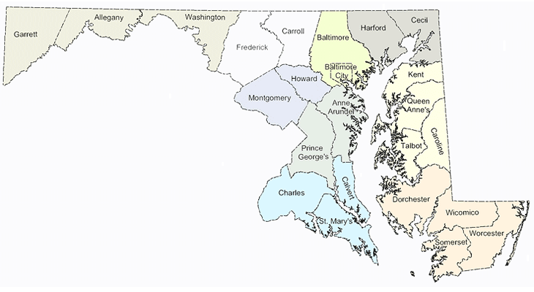
Total Patient Revenue (HSCRC first Prospective Global Budget Model)
W. Maryland HS $291m
Carroll Co.$202m
Wash. Co. $248m
Union of Cecil $128m
Garret Co. $42m
Frederick $220m
$1.0 Bill..
Chester River $56m
Mem. Easton $160m
Dochester $52m
$900 Mill.
Civista $111m
Calvert $118m
PRMC $375m
$355 Mill.
Atlantic Gen. $85m
St. Mary’s $126m
McCready $19m
HSCRC is establishing a fixed payment now for all Hospital services in 3 large more rural regions of the State

Slide 15
Example of a TPR Global Budget Model and Challenges associated with non-population based Global Budgets
Washington County Hospital (now Meritus)
  Community hospital in a rural part of the State
  Separated by distance and mountain ranges
  Serves 148,000 population in Washington County
  Limited “in-migration” from other parts of the State
  Budget in Prior year = $250,000,000
The hospital keeps its Global
Budget Revenue and associated
profit – and Budgets are 100%
Prospective and not “rebased”
to cost
Cutting “waste” under TPR =
Source of financial sustainability
Cost Inflation (CMS Market Basket)
Population aging/change impacts demand
HSCRC also began developing a version of the TPR for suburban hospitals with dominant
Market positions in their service area;
Challenge in establishing a Global Budget for Suburban and Urban hospitals was how to
adjust for demographic change in cases, where a Hospital does not have a well-defined PSA?

Slide 16
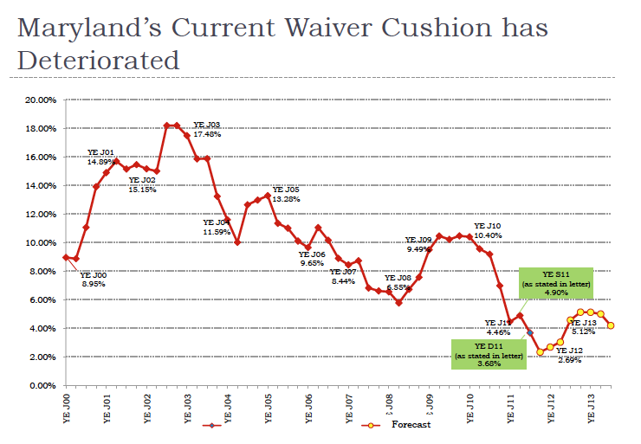
Peering over the Precipice
Maryland Legislature Medicaid Assessment and other factors led to large erosion in the Medicare waiver
The threat of the loss of the waiver helped to bring the hospitals on board
The Medicare Waiver “Relative Cushion” – experienced significant erosion

Slide 17
Objectives of the Payment Reform Efforts 2003-2011
Address issues undermining the lack of overall cost-constraint
  FFS Incentives and Excess Marginal Revenues
Develop incentives to improve hospital effectiveness (quality of care and patient safety)
Re-orient the system with incentives that would promote Population-Based Health
Position the system (given growing receptivity nationally to payment reform experiments) to replace the “Per Case” waiver test with a “Per Capita” test
Link system growth to growth in State Gross Product (GSP) to ensure “affordability and sustainability”
Sensitize CMS in 2009 and the CMMI in 2010 to the unique experiment that Maryland might provide
GLOBAL HEALTH PAYMENT, LLC

Slide 18
Implications of a Successful Maryland Model
Important model that demonstrates the need for direct payment mechanisms that have incentives to control volumes
  And/or reduce hospital resistance to efforts aimed at better care coordination and elimination of unnecessary volumes
Model these incentives further to promote population-based health under a system that provides financial sustainability for hospitals
Linking of growth to GSP and slowing hospital cost growth to 3.58% would be a remarkable achievement (other states only dream of this)
Global Budgets and Volume adjustments address an inherent contradiction in the national ACO policy
  ACOs built around hospitals with FFS incentives that will financial objectives that run counter to the goals of the ACO program
  By contrast Maryland hospital incentives (under a VAS or Global Budgets are aligned with the incentives of ACOs and other Market inducing entities)
Model will reduce emphasis on specialty care & elevate Primary Care and payment models such as the CareFirst PCMH that promote better value
Other States may follow Maryland’s lead (e.g., Vermont, West. Va., Oregon)
GLOBAL HEALTH PAYMENT, LLC

Slide 19
Are we there yet??
Not yet – but Donna will
tell us when we’ve arrived
High Value Health System
HSCRC
Waiver Limbo, IPPS and lose $1.5 billion
6 – Link to GSP growth and Discussions with feds
5 – Strategies to expand Global Budgets
4 – Aggressively Negotiated 10 TPRs
Buy docs, build, build, build – maximize revenues
3 – Expanded Bundles Admission-Readmission
Abandon Rate Setting
2 –Return of the VAS
1 –P4P Quality Based incentive programs
Massachusetts style
Monopolies
Some developments along the way may have provided some “traction”
Notes:
Today, I will describe Maryland’s Unique All-Payor Hospital Rate Setting system
This will include a discussion of the basic characteristics and key features
A review of the performance results and achievements of the system along the dimensions of Cost Containment, Access to Care, Equity in Payment, Financial Stability and Public Disclosure
Then I will turn to a discussion of the policy issues that Rate Setting can address. These are policy issues that most all countries face – whether they have centralized financing systems, a high degree of government control and intervention, or a fragmented pro-competitive system as in the USA.
Then finally conclude with summary observations

Slide 20
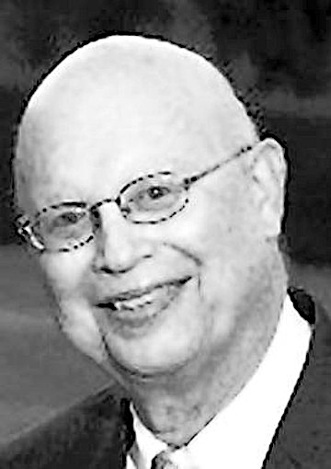
We owe it all to Hal!
Harold A Cohen, Founding Executive Director of
the Maryland Health Services Cost Review Commission
1939-2012

